Slide 1
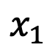
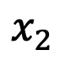
𝚫
$$x_{2}$$
$$x_{1}$$
2H
L
𝚫
2L
Notes:
Schematic of plane stress pure shear test geometry with height of $2h$ where crack length is half the length of the domain, $2L$. Displacement is denoted by $\Delta$.

Slide 2
r
2h₀
2H
c
2L

Slide 3
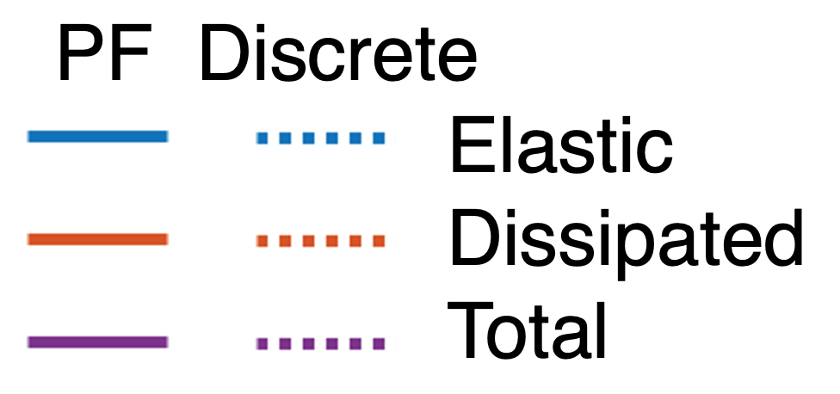
Width of Phase Field
a)
b)
Notes:
Figure 1: a) Comparison of the Mode I deformation field $y_1$ and $y_2$ simulation results with the range of the analytical solution. Simulation results include phase-field results (red) where the phase-field is diffused over 20 elements and discrete crack geometry (black) b)

Slide 4
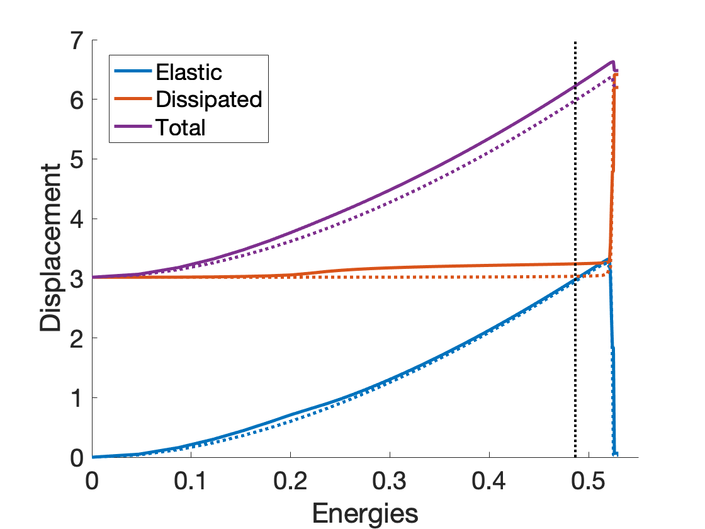
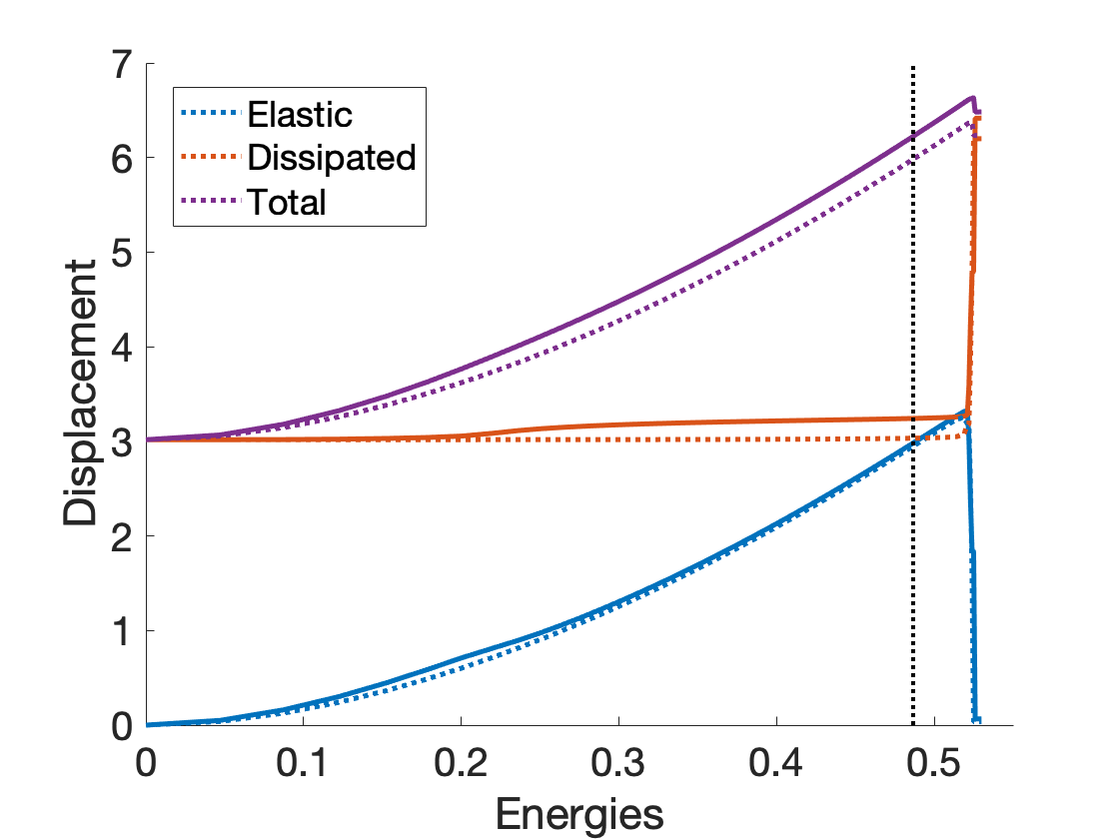
PF Discrete
Elastic
Dissipated
Total

Slide 5

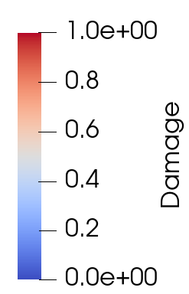
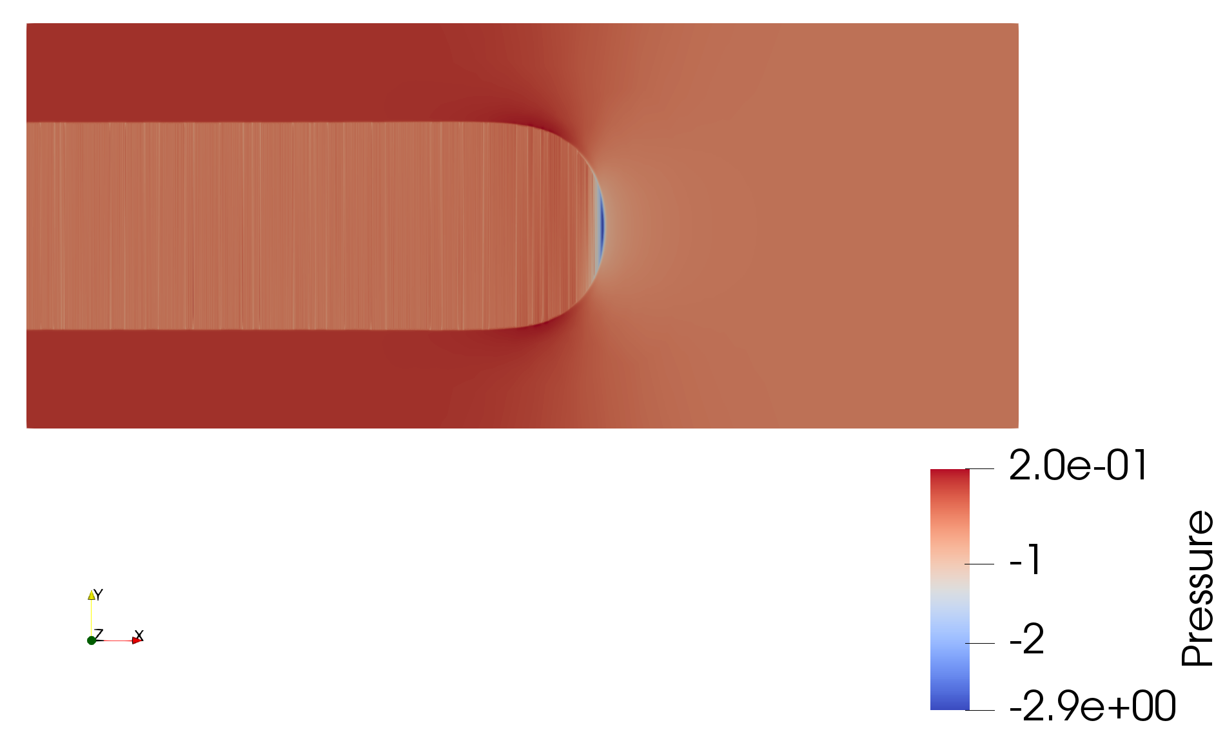
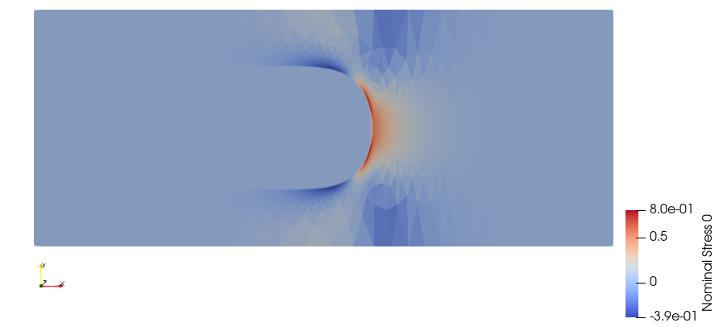
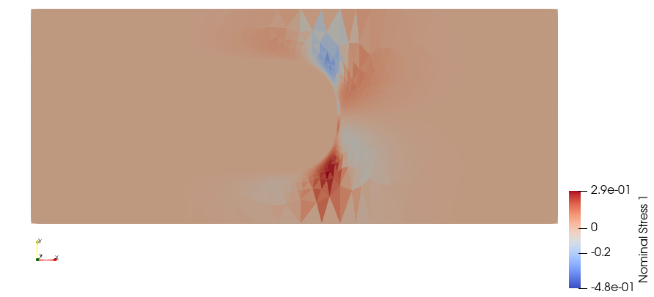
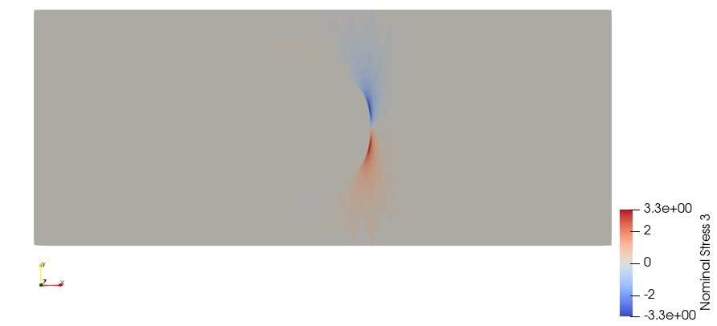
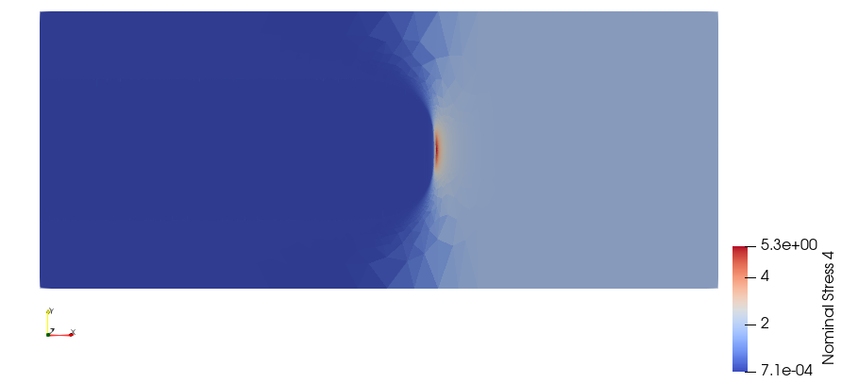
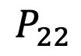
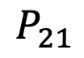
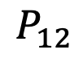
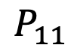
a)
b)
$$P_{11}$$
$$P_{12}$$
$$P_{21}$$
$$P_{22}$$
c)
Notes:
Figure 2: Current configuration of plane-stress pure shear test results with height, $2h = 1$, and length $2L = 6$ where the element size, $h_{size} = 0.002$. The fracture energy, $G_c = 1$, shear modulus, $\mu = 1$, and bulk modulus $\kappa = 1 \times 10^5$ are specified and the sample is loaded until crack propagation. a) Phase-field (damage) field where the damage field is specified over 20 elements, b) pressure, and ) relevant components of the nominal stress field.

Slide 6
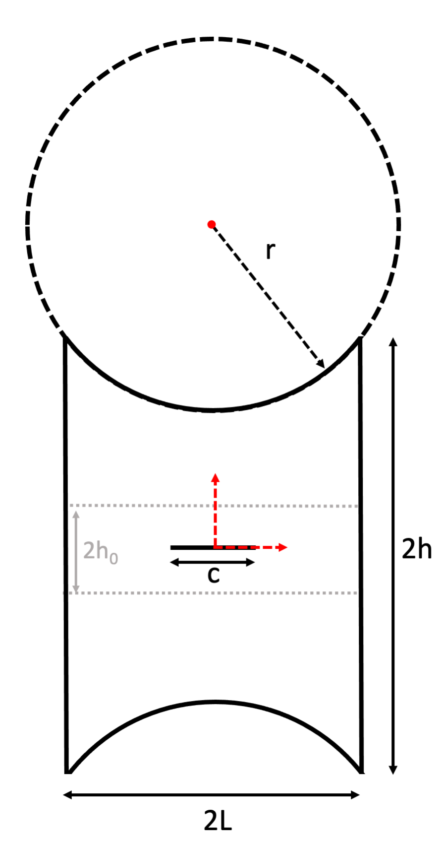
a)
b)
Notes:
Figure 3:
a) Simulation geometry to study stable crack propagation in 2D motivated by trapezoidal simulations \cite{} where length and height are defined as $2L$ and $2h$ respectively. A region of $2h_0$ allows for uniform refinement for the phase-field method. A circle with radius $r$ is used to define the top and bottom surface and b) the evolution of the energies as the displacement on the top surface is increased and the bottom surface is held fixed.

Slide 7
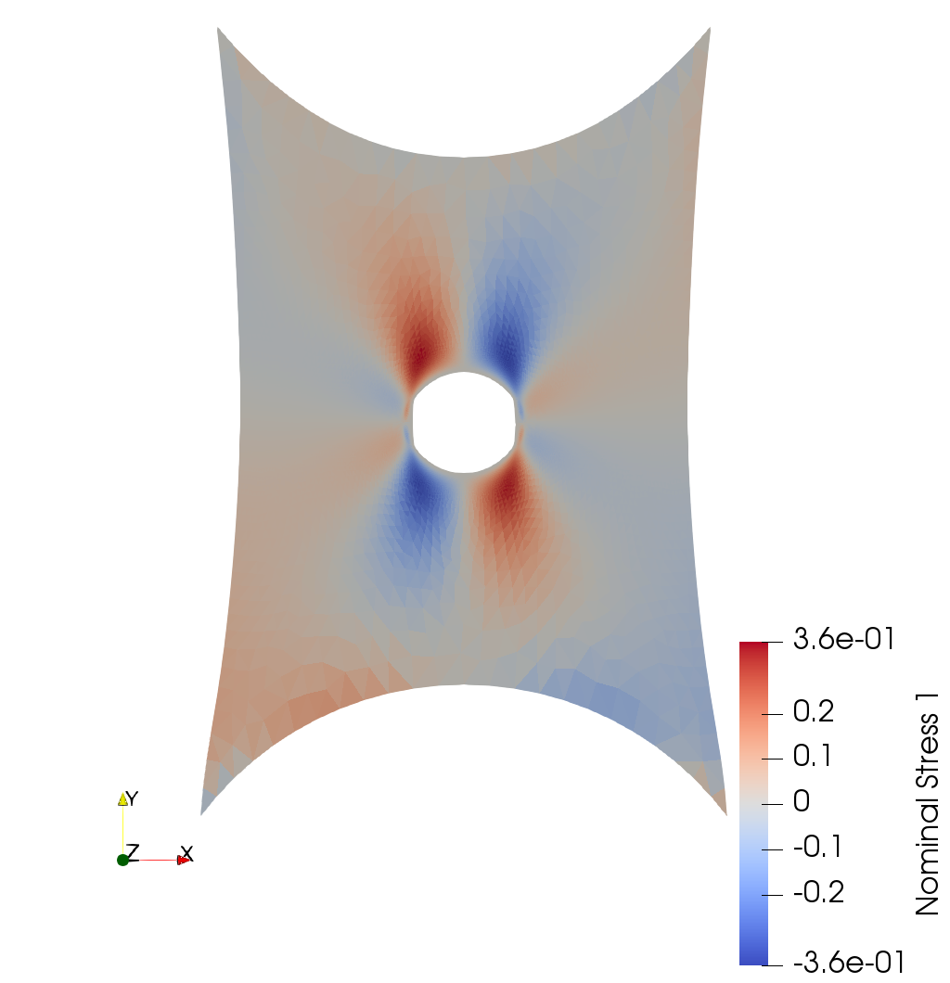
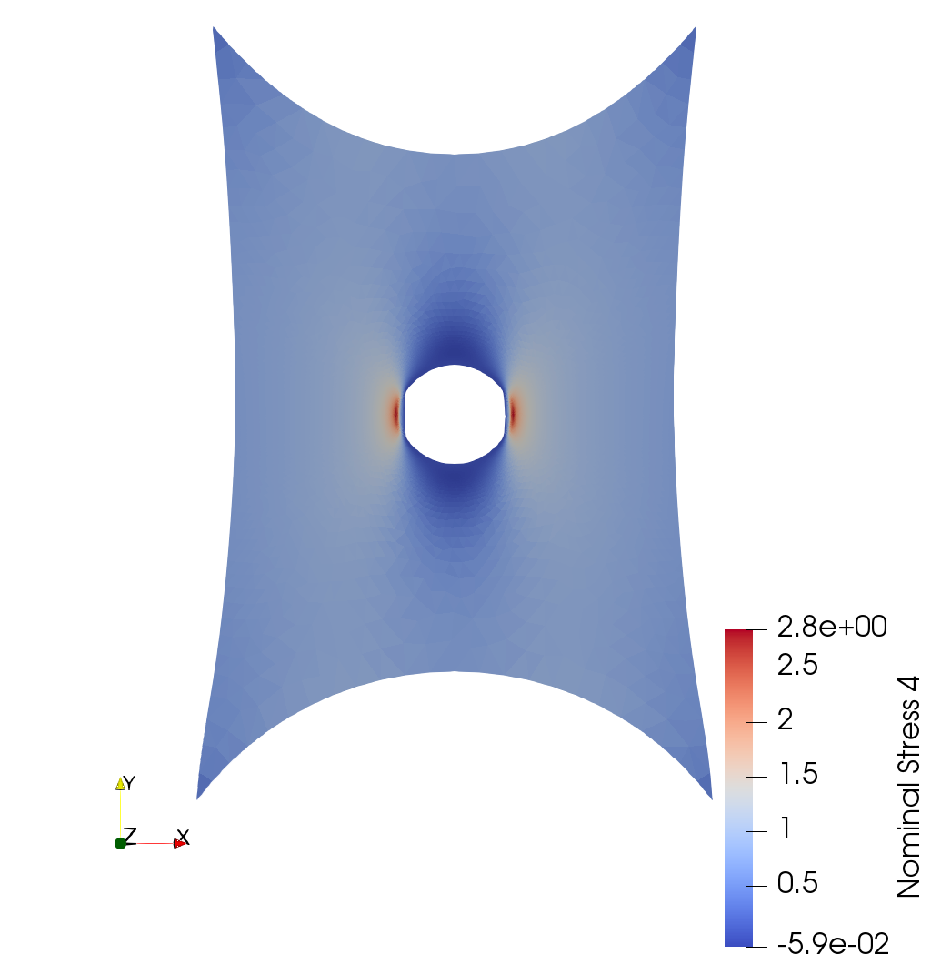
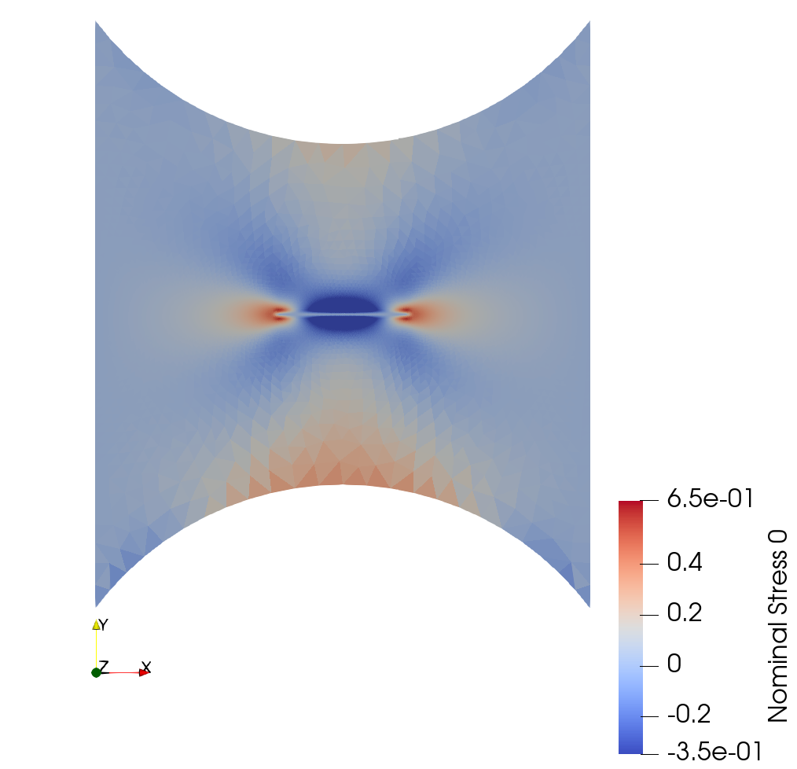
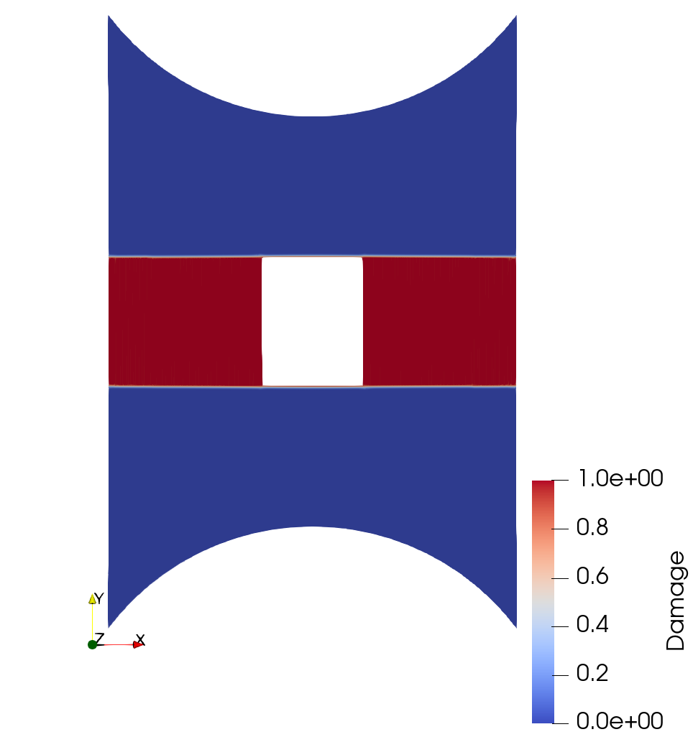
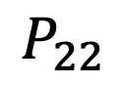
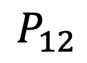
$$P_{12}$$
$$P_{22}$$
a)
b)
1
2
3
4
5
Notes:
Figure 4:
Current (deformed) configuration of geometry designed to induce stable crack propagation where length and height are specified as, $2L = 8$, $2h = 9.5$. The center of the circle is (0, $\pm 7.75$) with $r = 5$. The fracture energy, $G_c = 1$, shear modulus, $\mu = 1$, and bulk modulus $\kappa = 1 \times 10^3$ are specified and the sample is loaded until crack propagation. a) Components of nominal stress in the step immediately prior to full fracture of domain and the b) evolution of the damage field with increasing displacement.

Slide 8
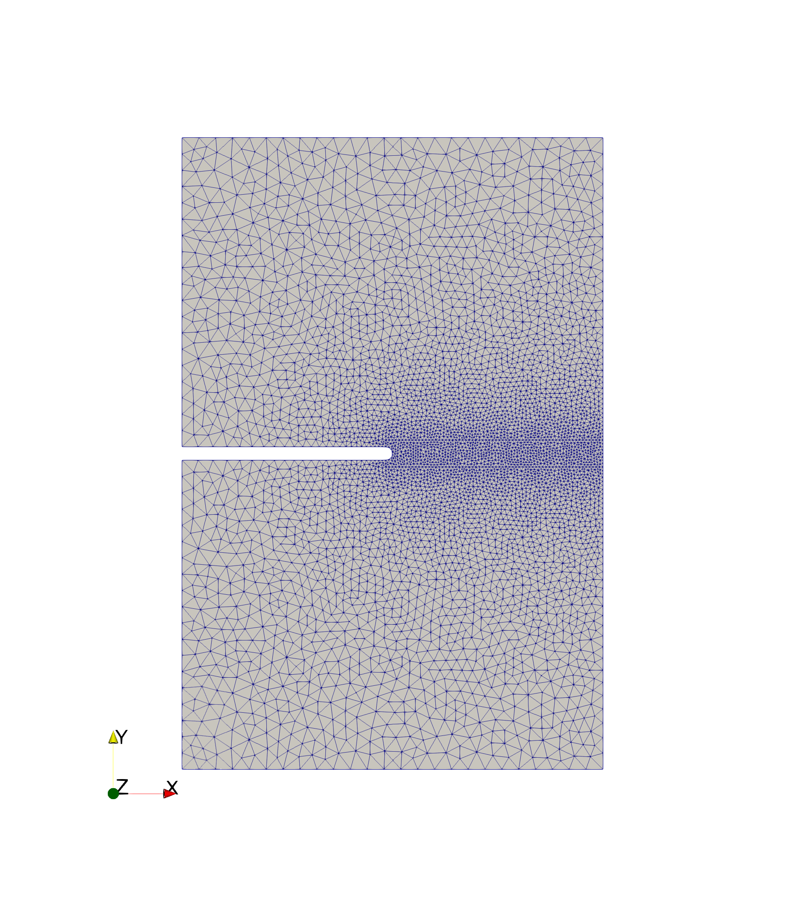
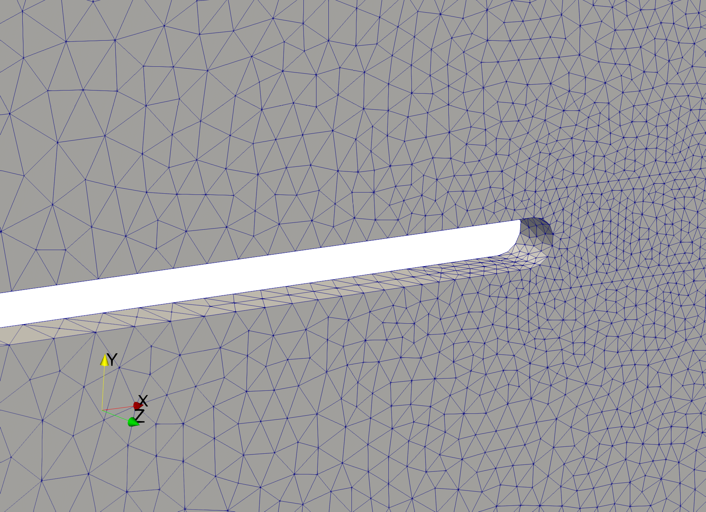
L
H
Notes:
Figure 5
3D geometry

Slide 9
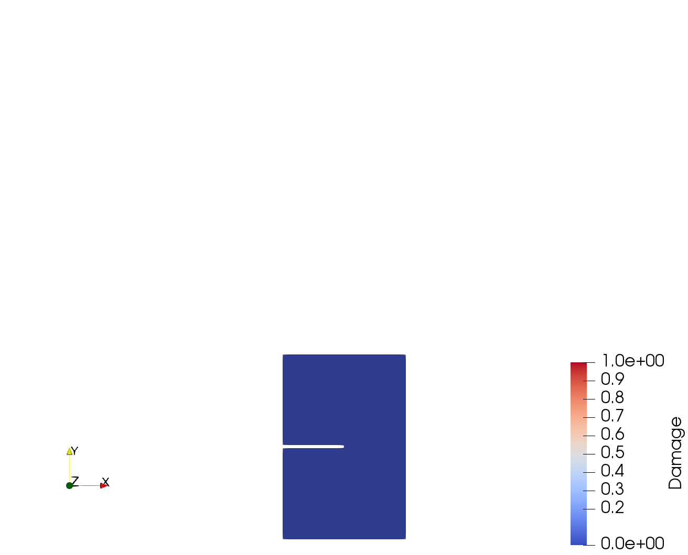
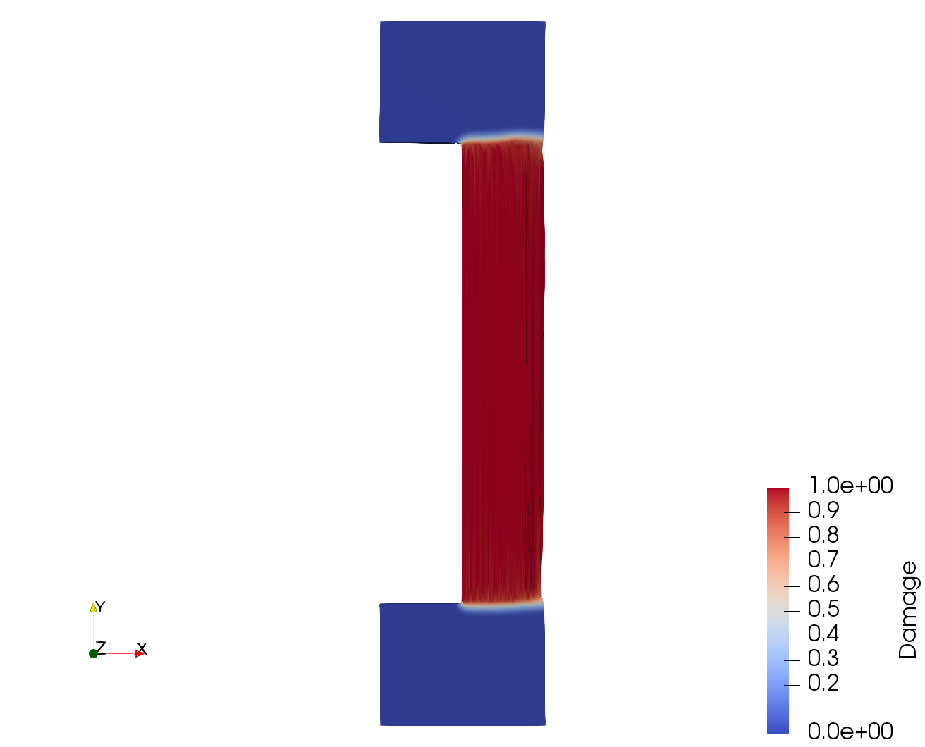
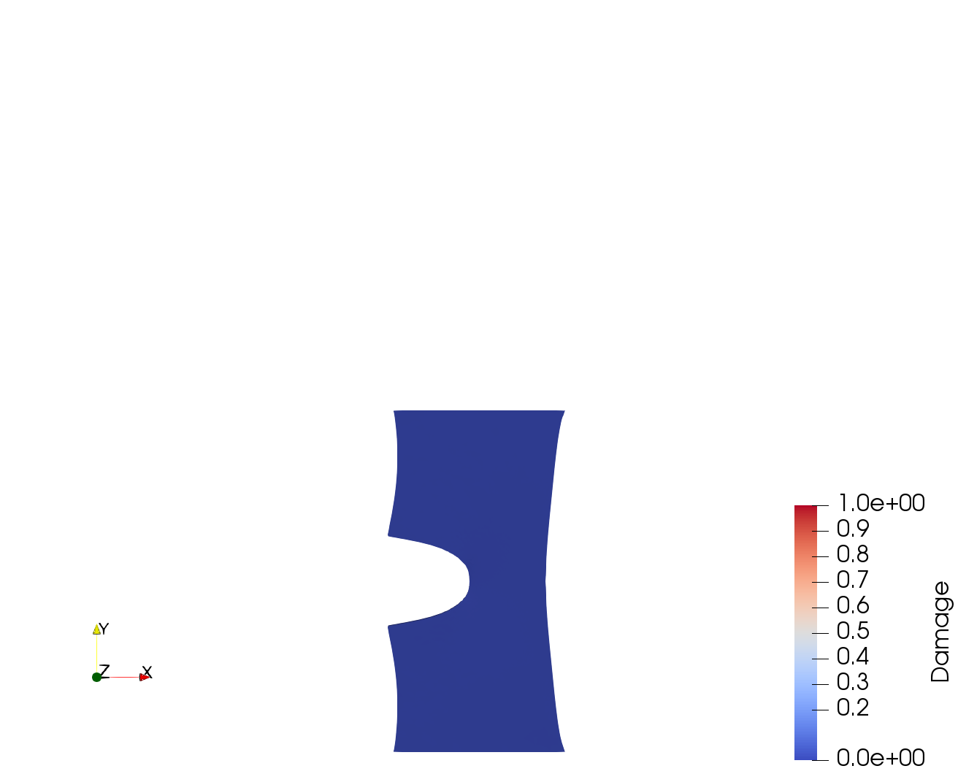
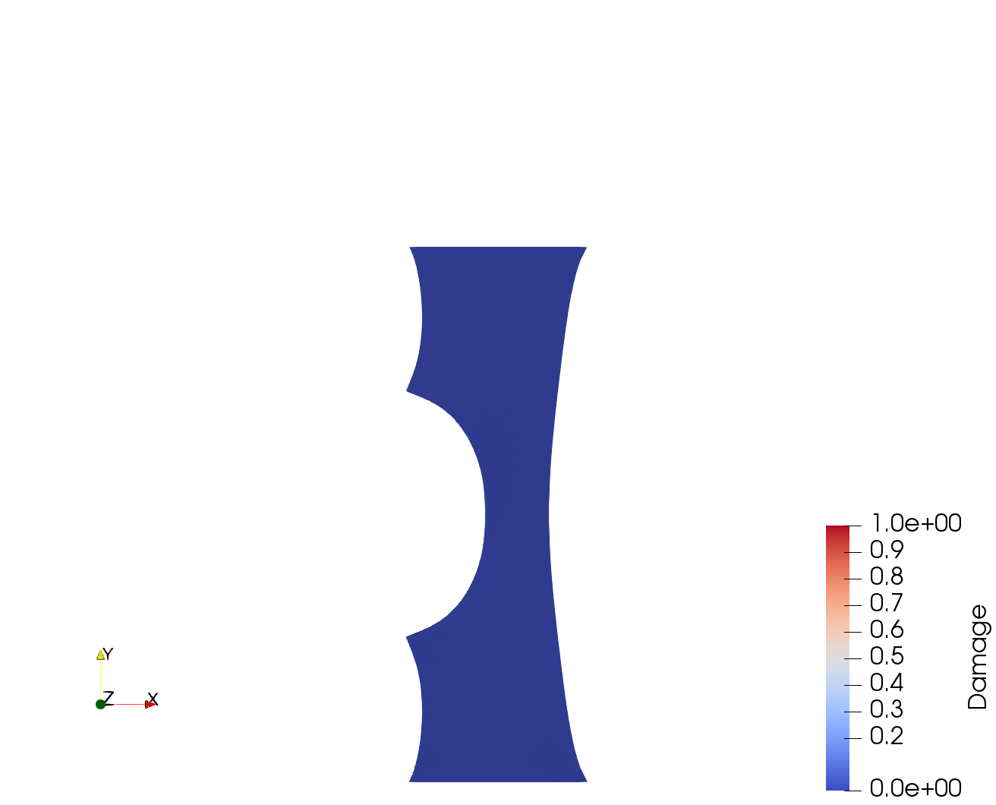
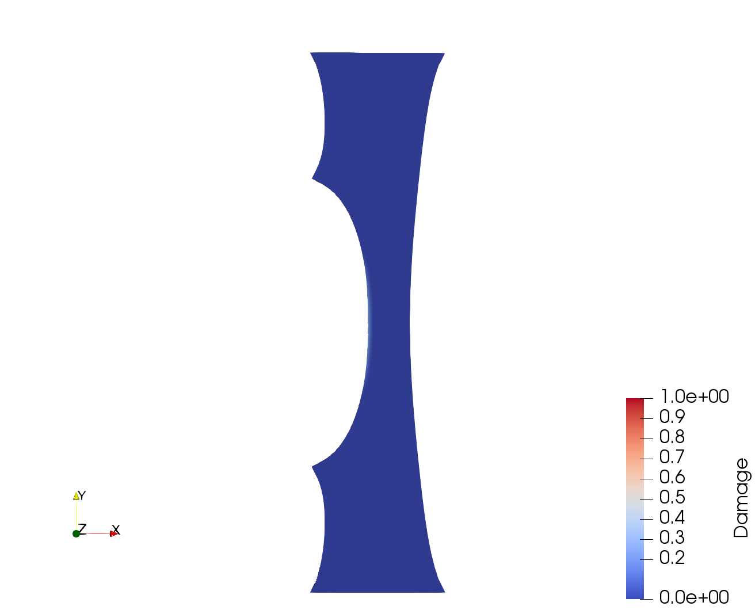
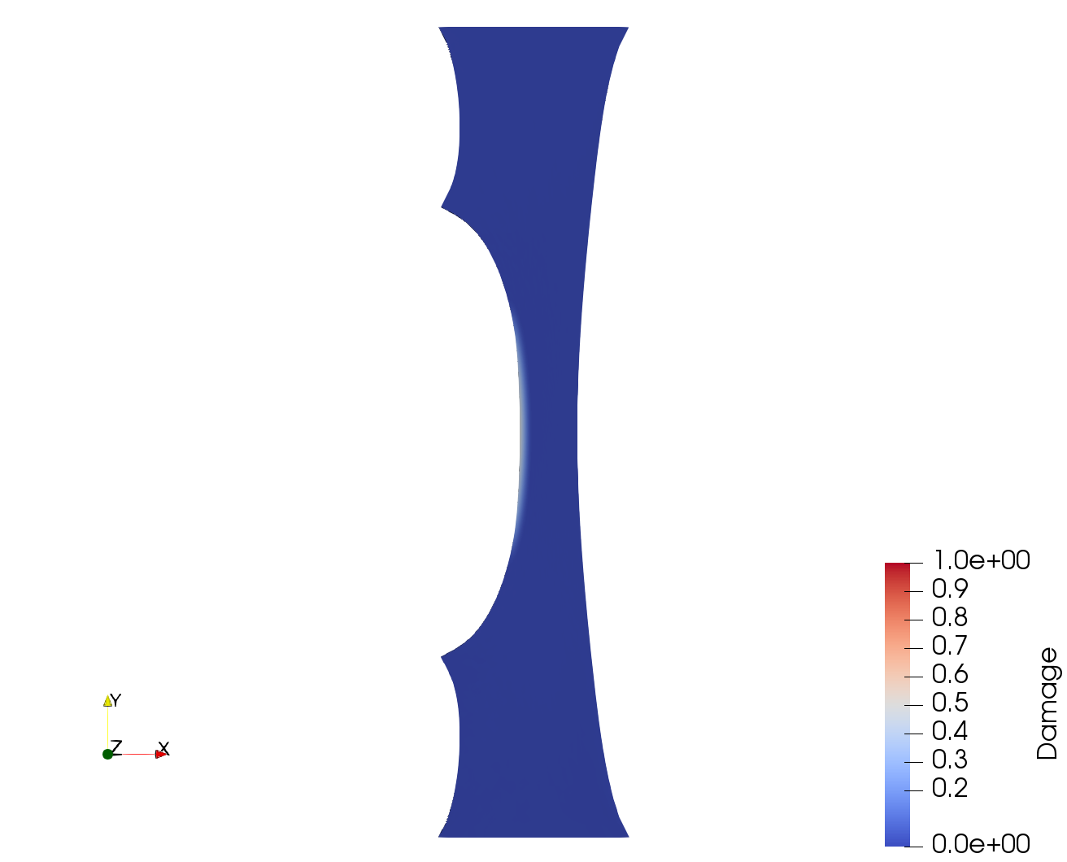
1
2
3
4
5
6
Notes:
Figure 6:
0, 50, 150, 250, 274, 275

Slide 10
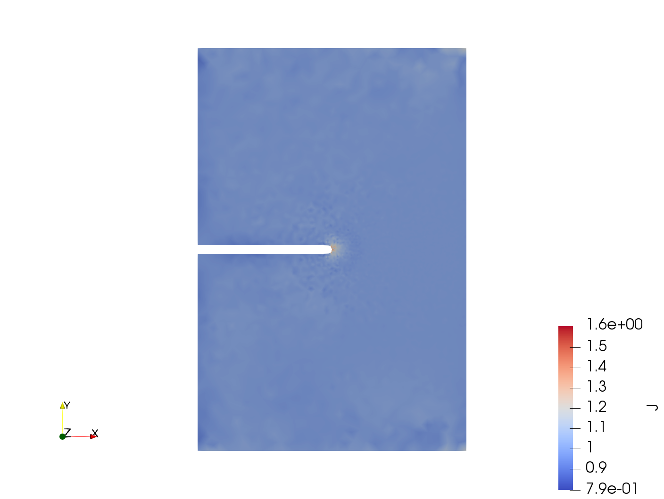
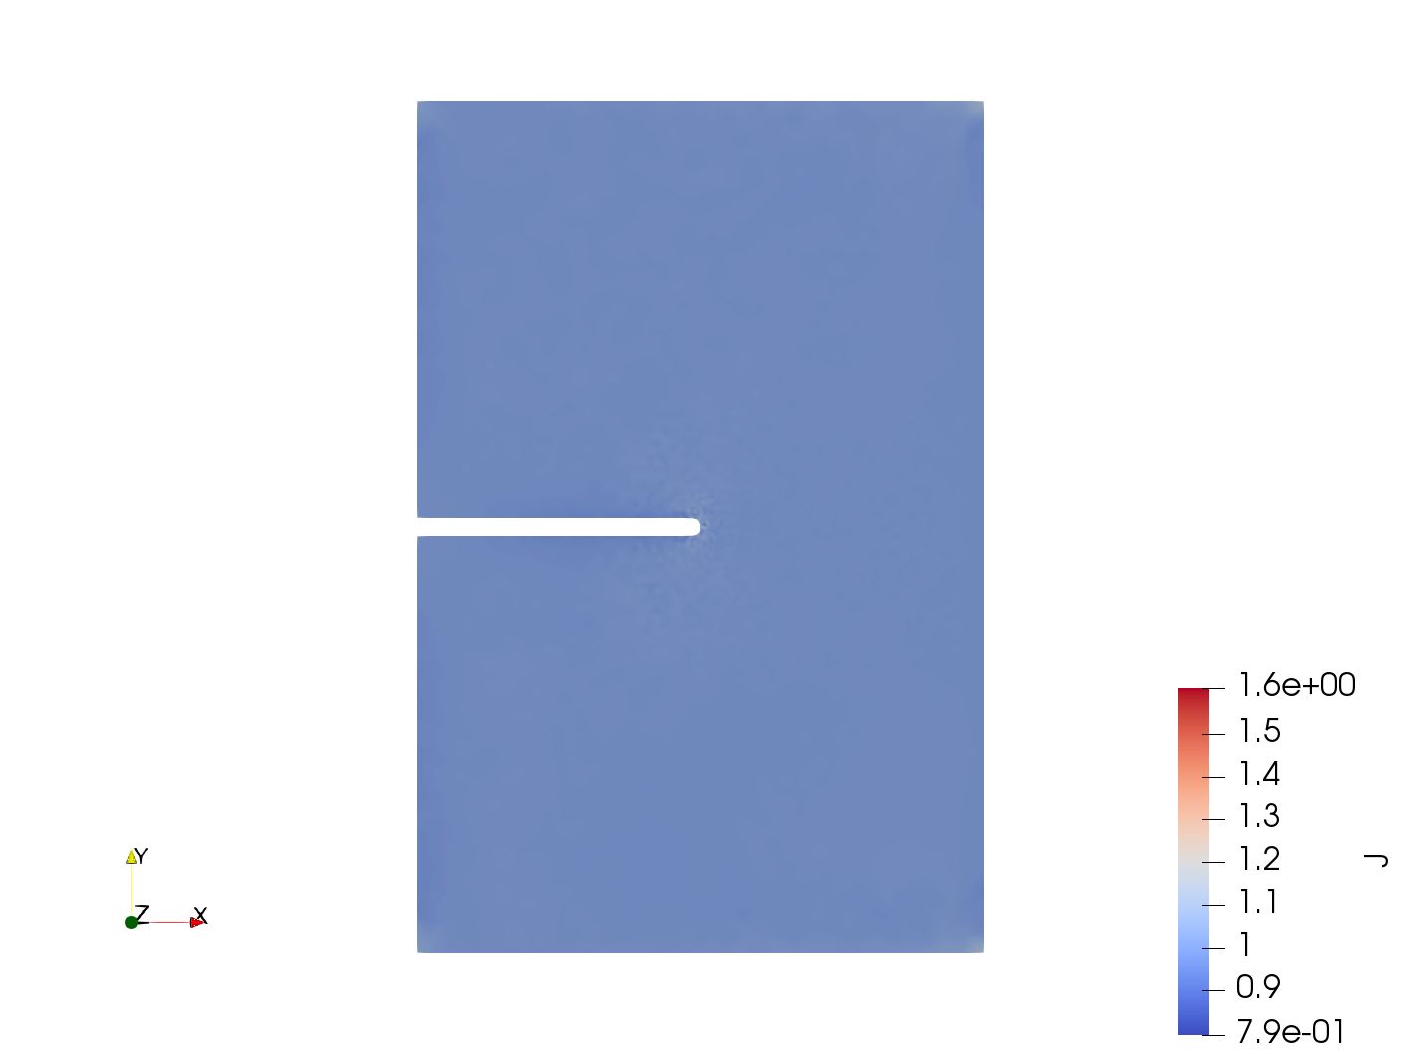
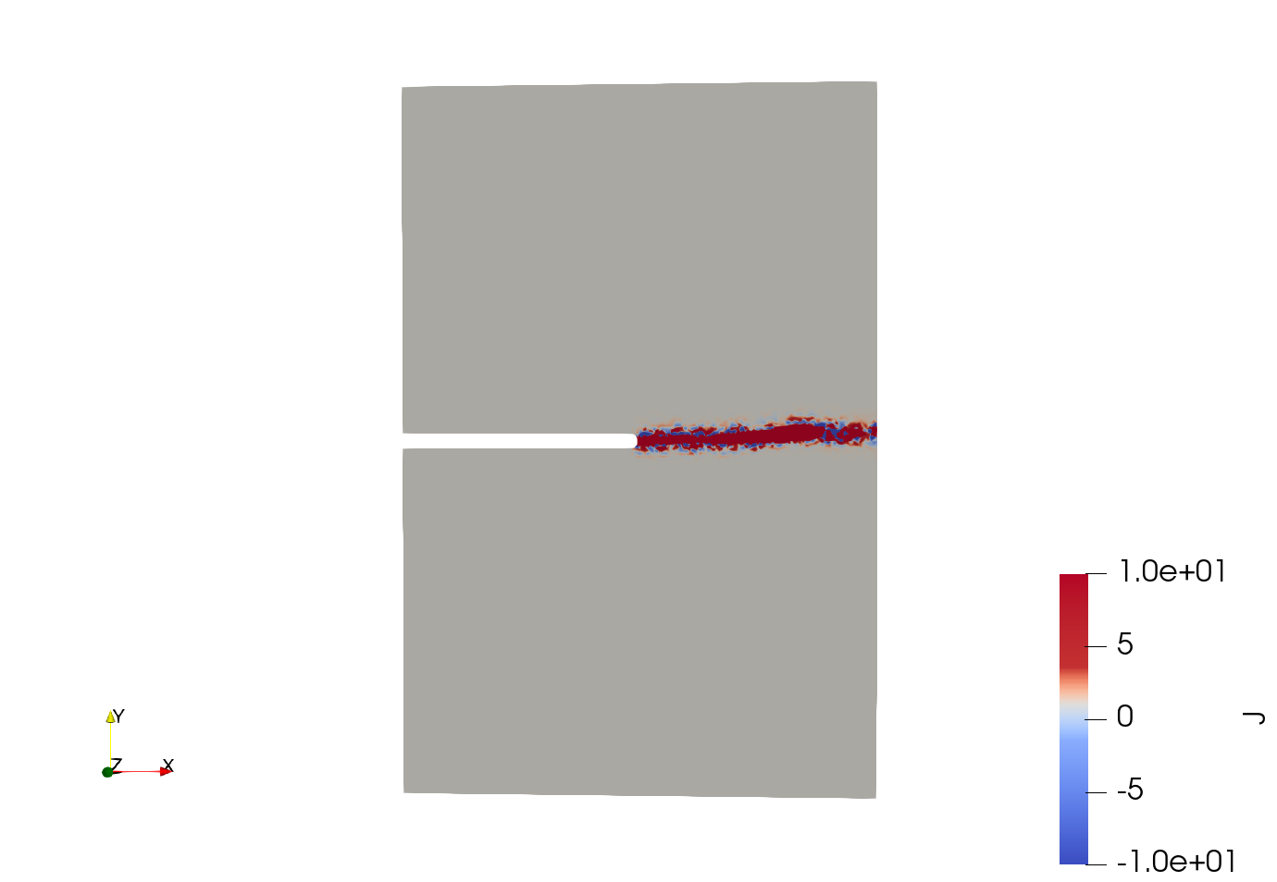



a)
b)
c)
Notes:
Figure 7:
0, 50, 150, 250, 274, 275

Slide 11
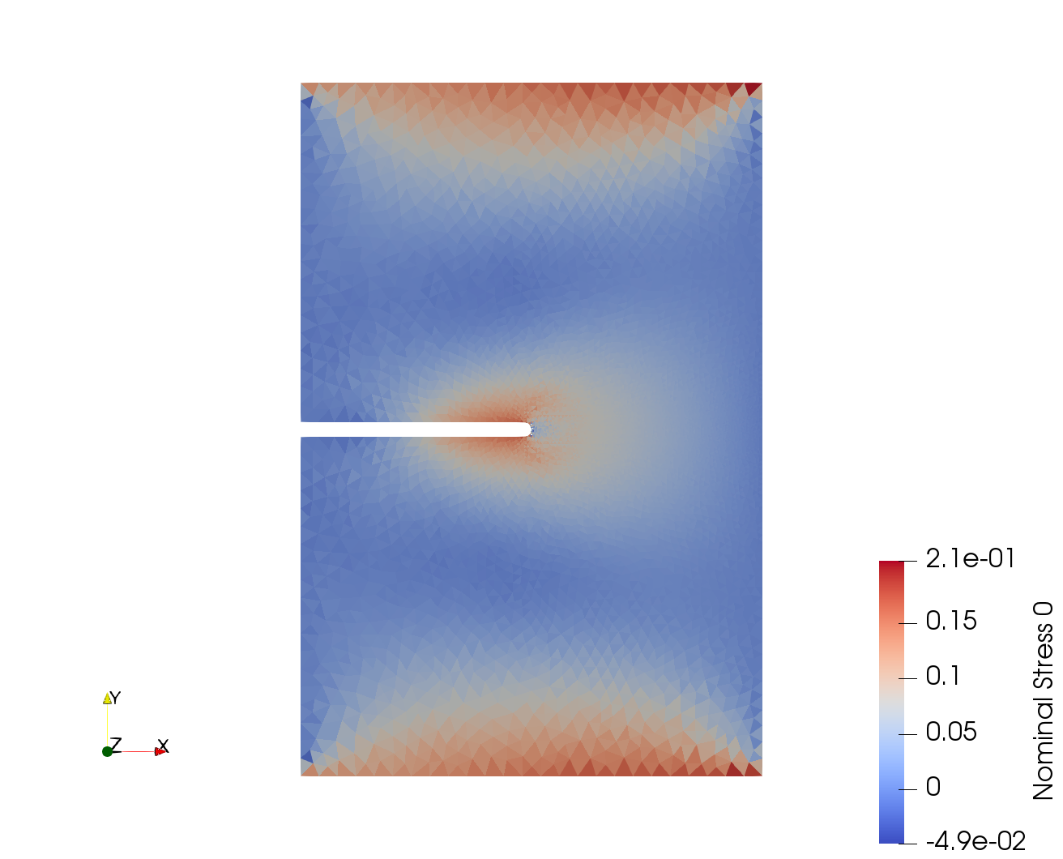
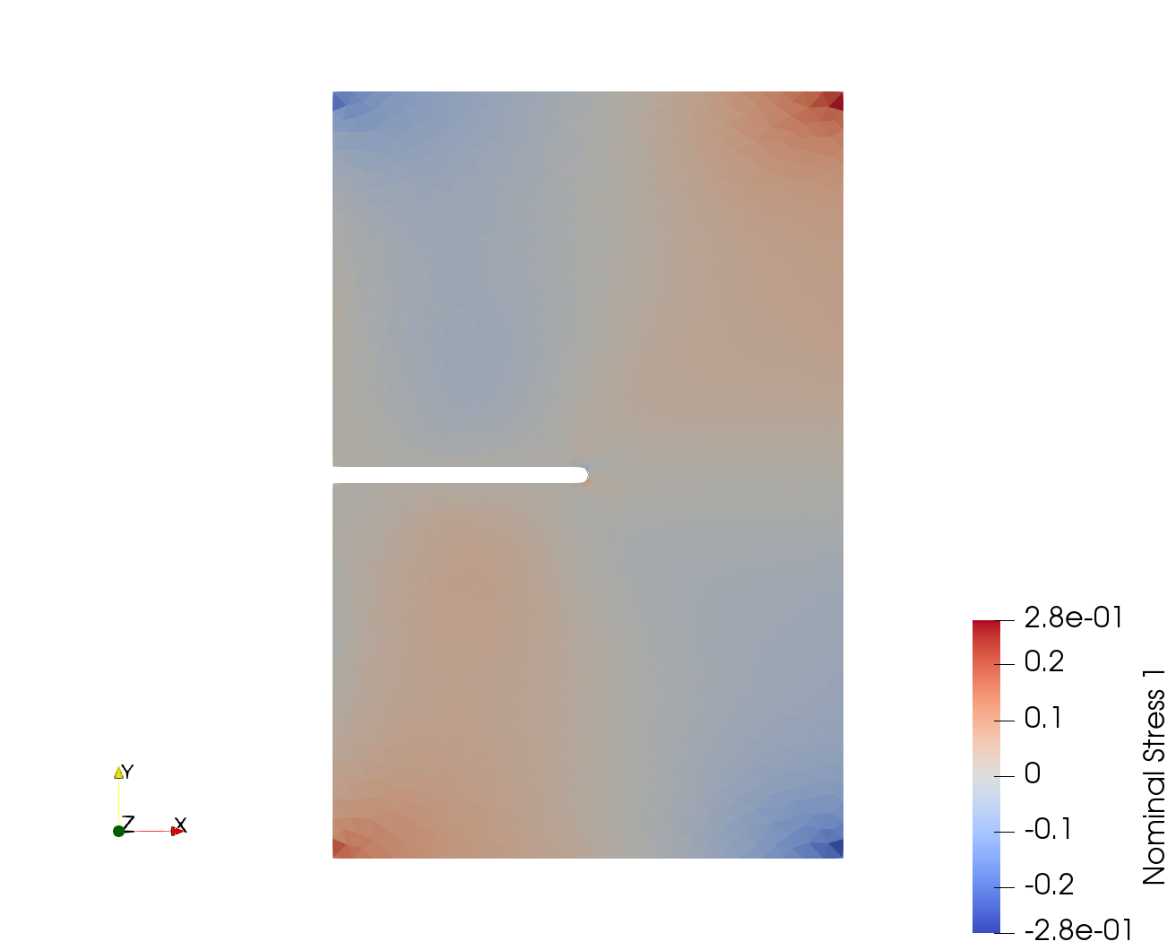
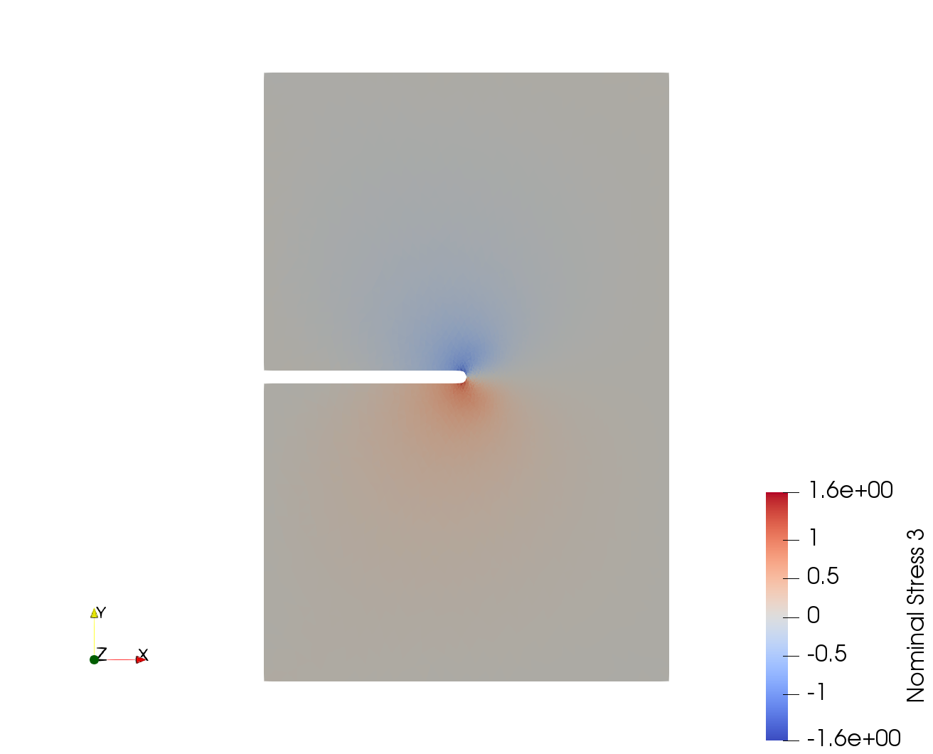
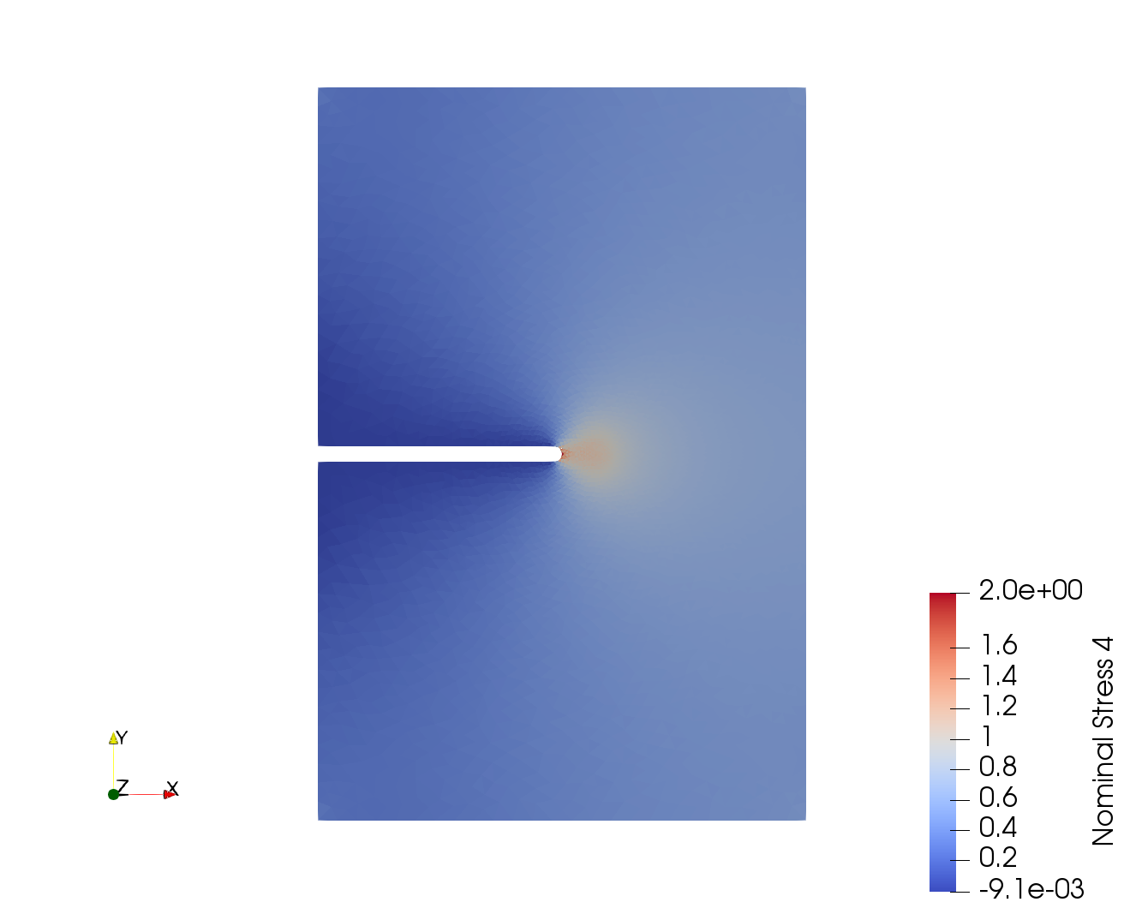
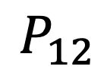
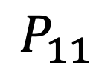
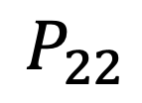
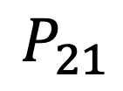
$$P_{11}$$
$$P_{12}$$
$$P_{21}$$
$$P_{22}$$
Notes:
Figure 8

